Slide 1


Inventory Management System

Slide 2
Members
Name UID
Aaryan Kedia 20BCS3104
Yash Tyagi 20BCS3346
Prince Kumar 20BCS3147
Tushar 20BCS3096
Co-supervisor Name: Vaneet Kumar
Ecode: E11321
Submitted To: Ankita Dhiman
Ecode: E11431
Group Leader: Aaryan Kedia

Slide 3
INTRODUCTION
For organizations that handle transactions involving consumer goods, an inventory management system is essential for quality control. A large mercantile establishment may run out of providers of a critical item if inventory isn't properly managed. Once it’s time to reorder, an efficient inventory management system can inform the retailer.
This inventory management system is additionally helpful for chasing huge shipments automatically. Counting every pair of stocks by hand will almost definitely end in a mistake. The chance of human error may be reduced by using an automatic inventory management system.
An inventory Management System also aids in the chase of retail product theft, providing helpful info relating to store revenues and therefore the need for theft-prevention devices.
Inventory Management System can perform a variety of tasks. It can assist a warehouse employee in locating things on an order list, encrypting cargo information, appreciating tracking numbers and delivery addresses and removing purchased items from the inventory tally to keep up an accurate count of in-stock items.
INTRODUCTION

Slide 4
Objectives
The purpose of the Inventory system is to serve customers efficiently. This study aims to help the shop make their work faster by using the system where they can monitor the remaining products in the records where they can see in the database. The system will provide a good service to the company like better transaction process that brings bigger profit.
To develop a module that generates reports monthly sales and inventory.
To develop security in terms of keeping the records of the inventory.
To develop a system that can monitor the stocks in and stock out and the inventory in a fast and efficient manner.
To accurately record, compute and produce a report of sales.

Slide 5
Technology Used
APACHE NETBEANS :- NetBeans IDE is a free and open source integrated development environment for application development on Windows, Mac, Linux, and Solaris operating systems.
XAMPP :- XAMPP helps a local host or server to test its website and clients via computers and laptops before releasing it to the main server. It is a platform that furnishes a suitable environment to test and verify the working of projects based on Apache, Perl, MySQL database, and PHP through the system of the host itself.
MYSQL WORKBENCH :- MySQL Workbench is a unified visual tool for database architects, developers, and DBAs. MySQL Workbench provides data modeling, SQL development, and comprehensive administration tools for server configuration, user administration, backup, and much more.
Icon8:- It is an online Website which provides us with a free icon for our Software. They have a great choice of consistent, pixel-perfect icons that cover all our needs. Now we're thinking about API integration to automate the procedure of adding new icons to our app.
.

Slide 6
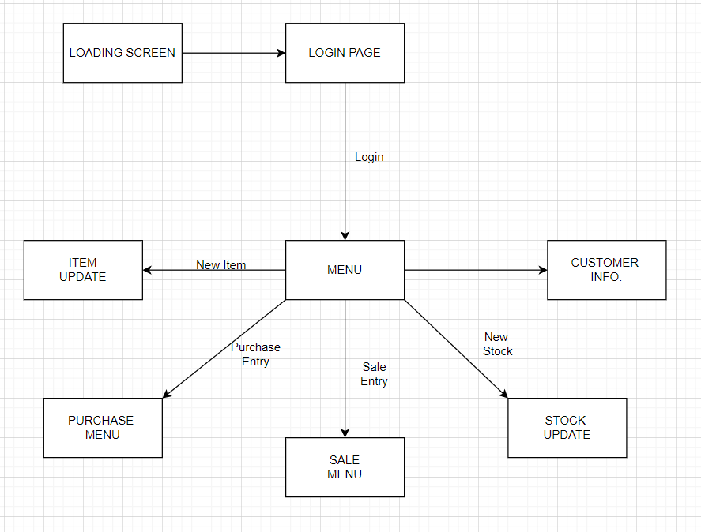
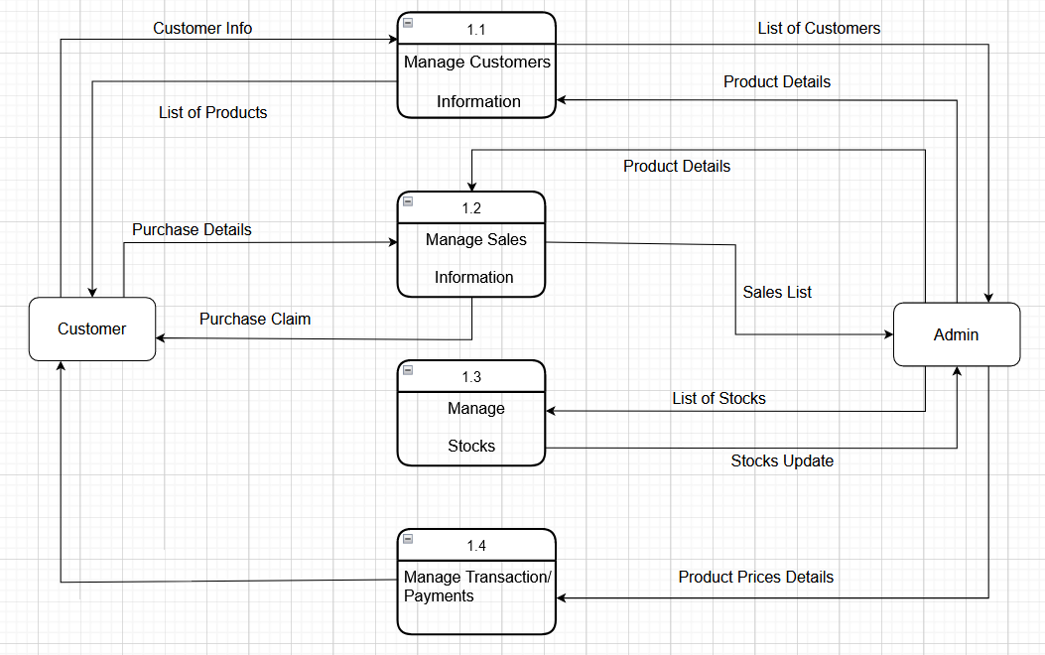
Designs
DFD (LEVEL 0) :-
DFD (LEVEL 1) :-

Slide 7
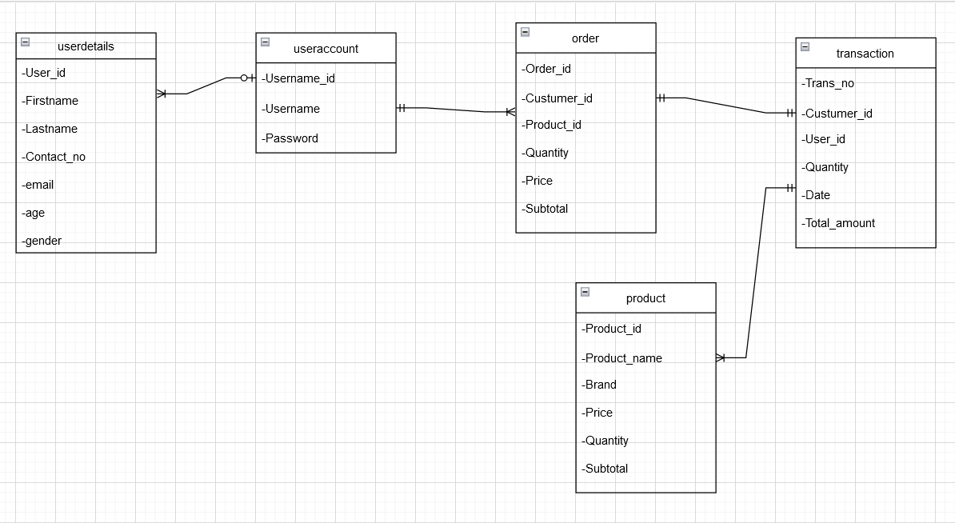
Class Diagram :-

Slide 8
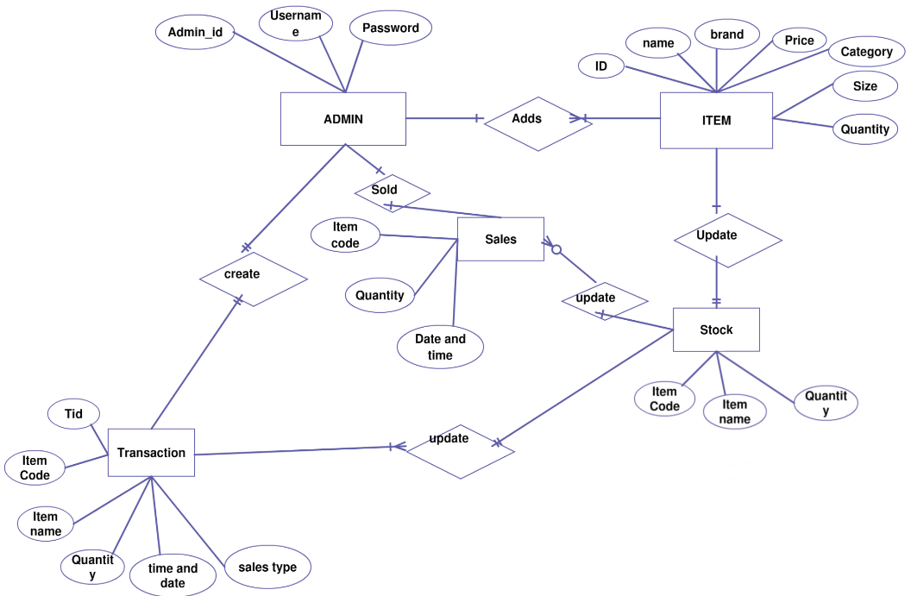
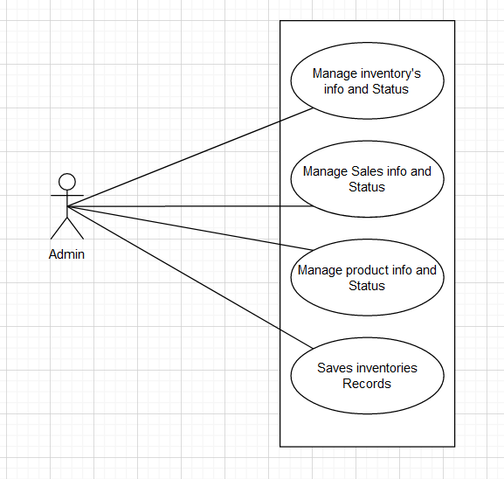
ER Diagram :-
Use Case Diagram :-

Slide 9
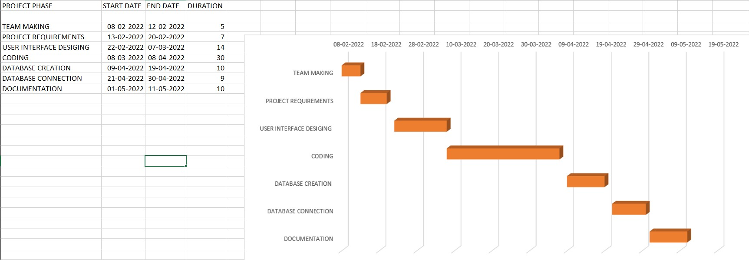
Gantt Chart :-

Slide 10
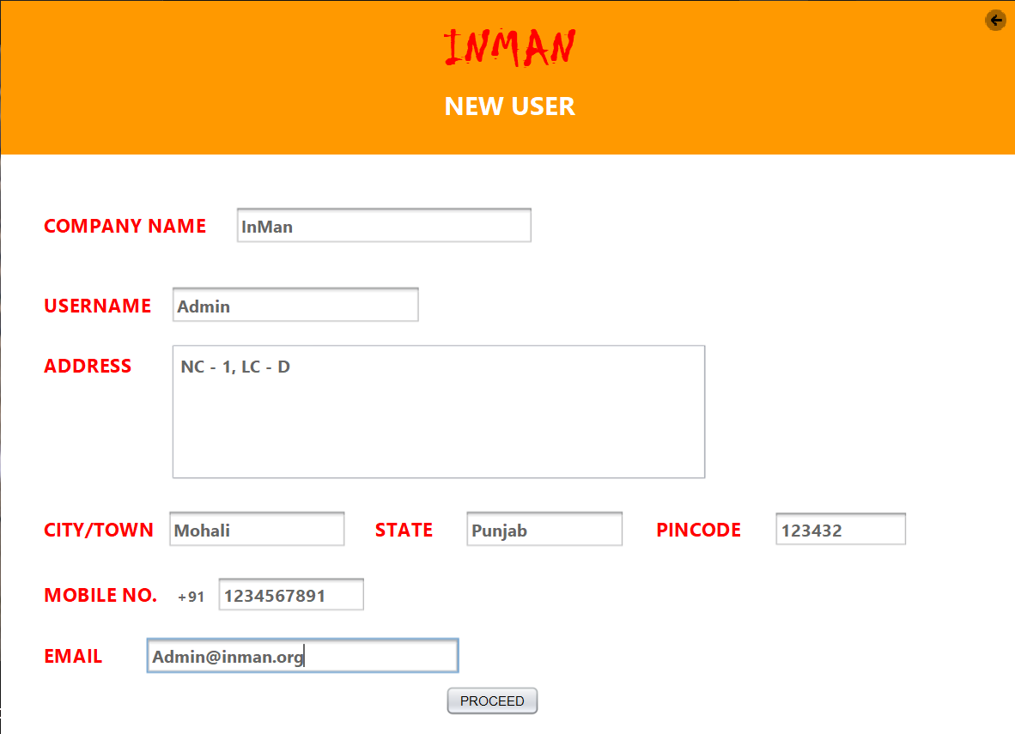

SNAPSHOTS
Login
Signup

Slide 11
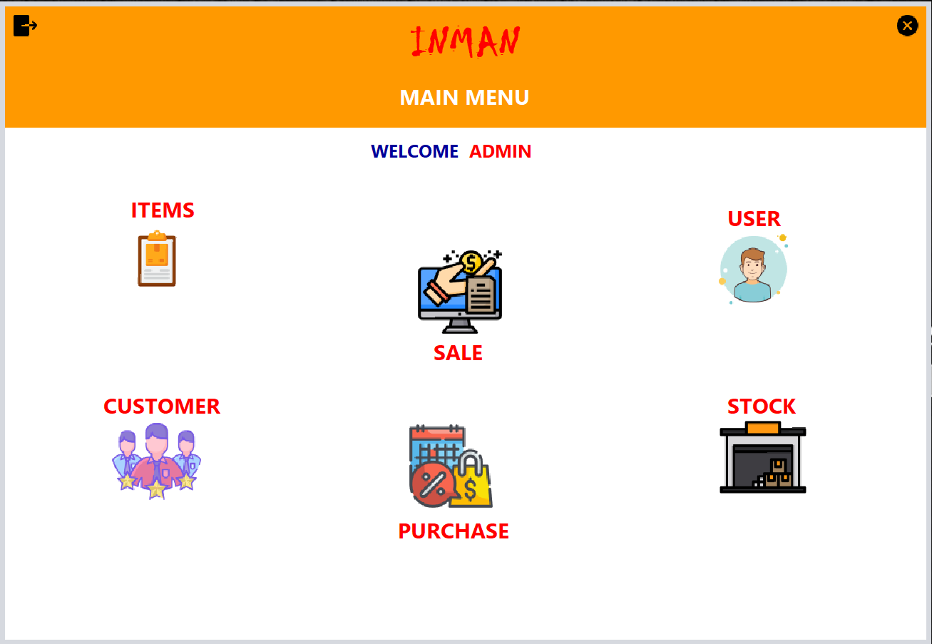
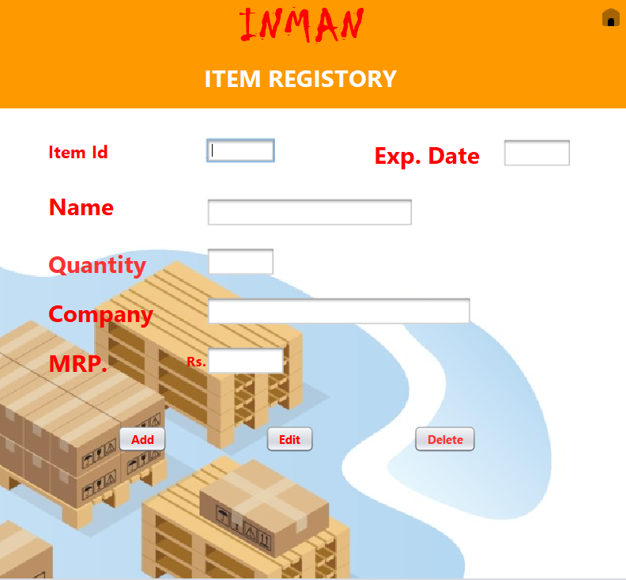
Item Register
Main Menu

Slide 12
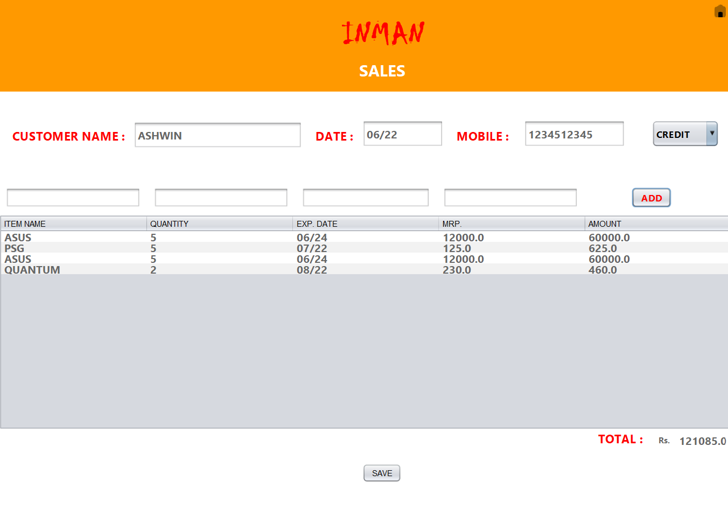
Sales -

Slide 13
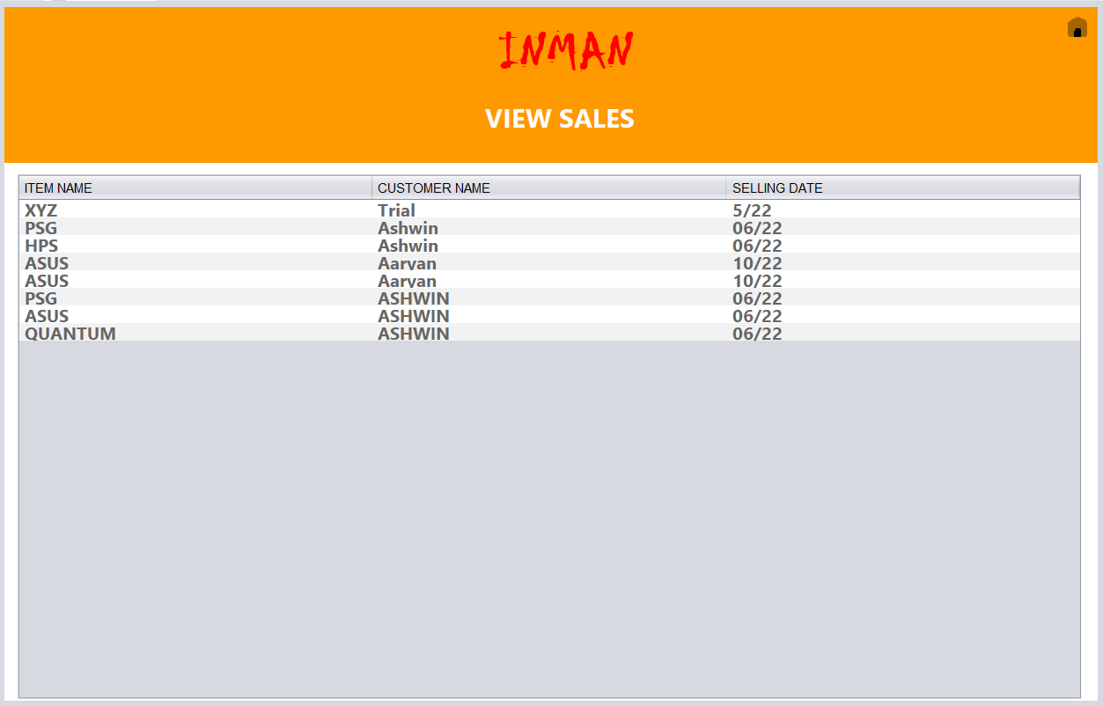
Sales -

Slide 14
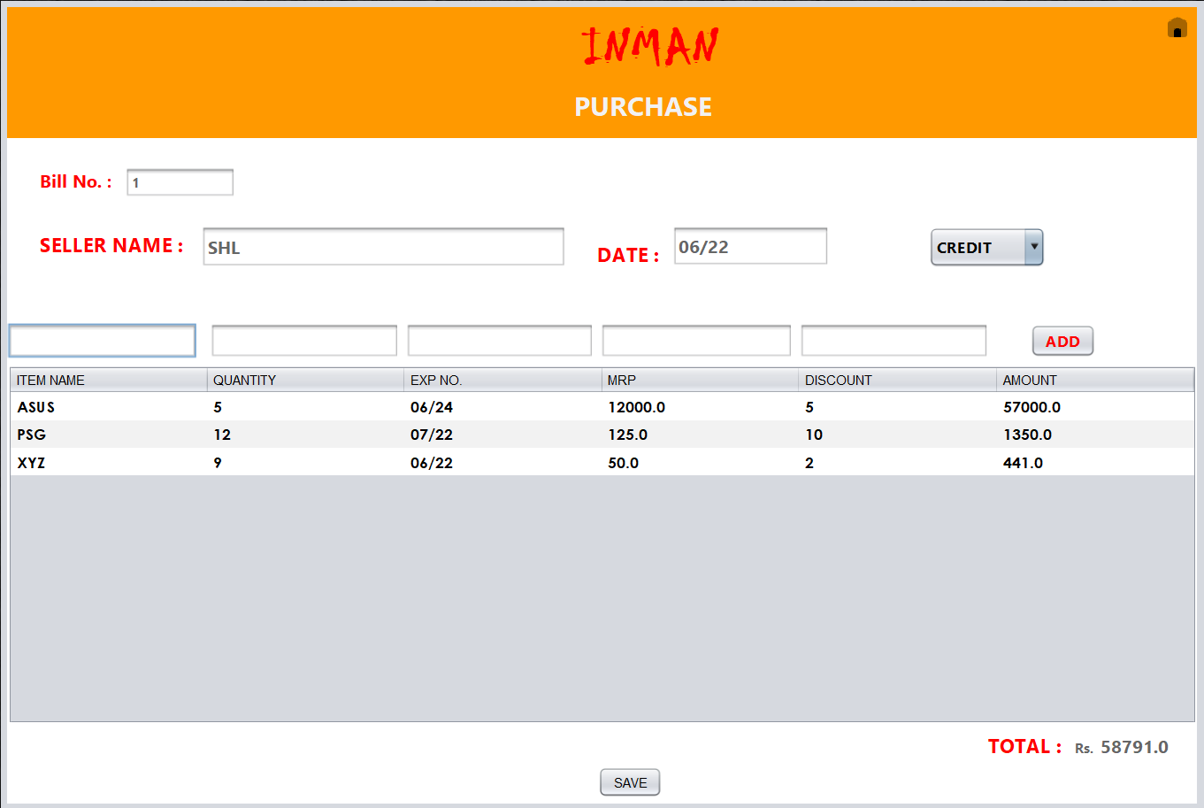
Sales -

Slide 15
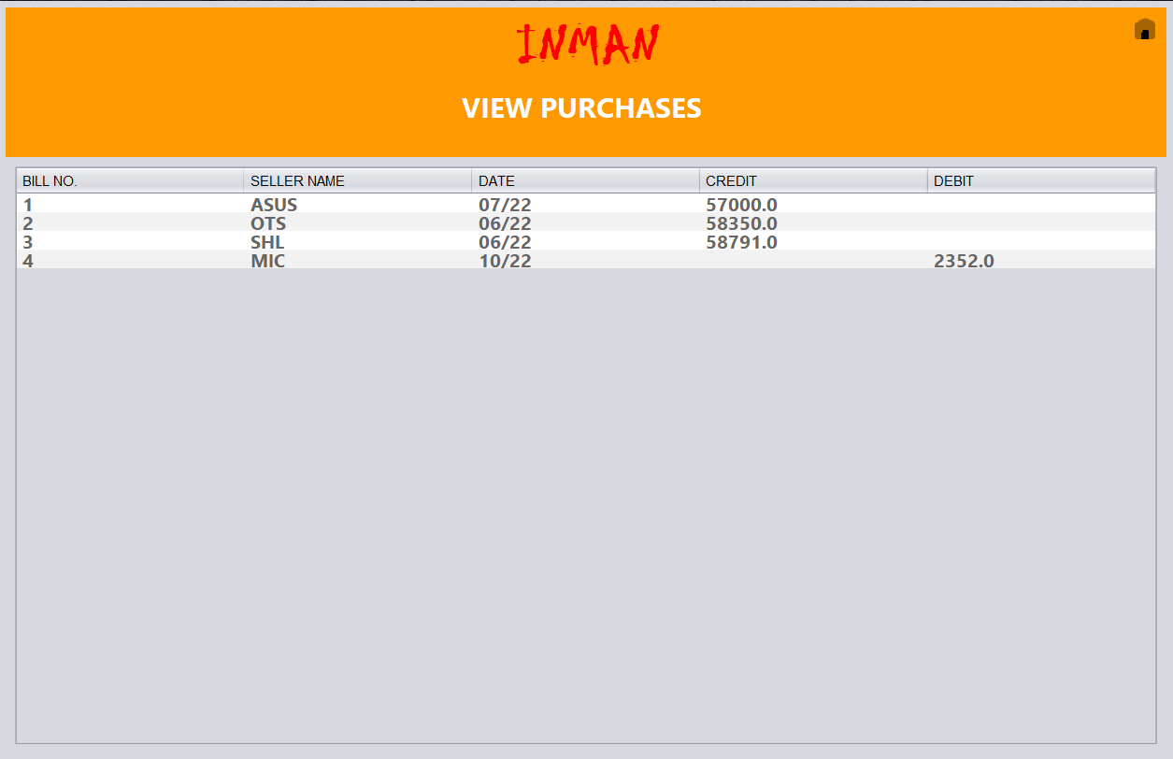
View Purchase -

Slide 16
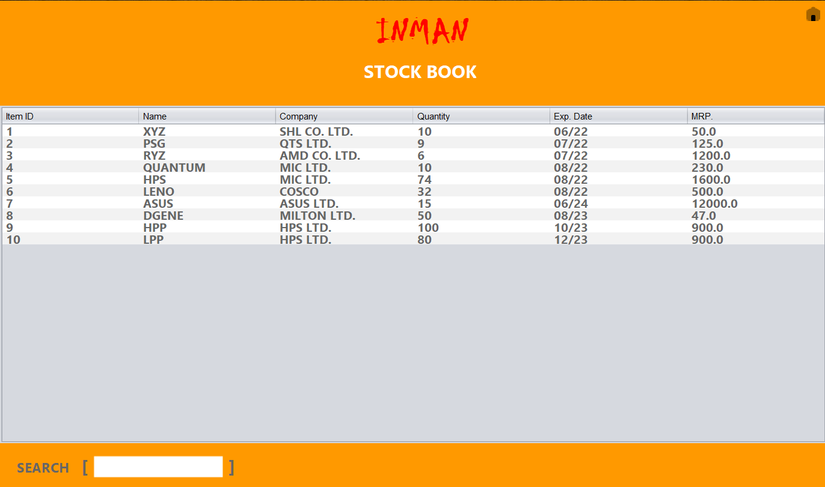
Stock Book -

Slide 17
Outcomes
Better Inventory Accuracy: With solid inventory management, you know what’s in stock and order only the amount of inventory you need to meet demand.
Reduced Risk of Overselling: Inventory management helps track what’s in stock and what’s on backorder, so you don’t oversell products.
Cost Savings: Stock costs money until it sells. Carrying costs include storage handling and transportation fees, insurance and employee salaries. Inventory is also at risk of theft, loss from natural disasters or obsolescence.
Avoiding Stockouts and Excess Stock: Better planning and management helps a business minimize the number of days, if any, that an item is out of stock and avoid carrying too much inventory. Learn more about solving for stockouts in our “Essential Guide to Inventory Control.”
Greater Insights: With inventory tracking and stock control, you can also easily spot sales trends or track recalled products or expiry dates.

